Slide 1
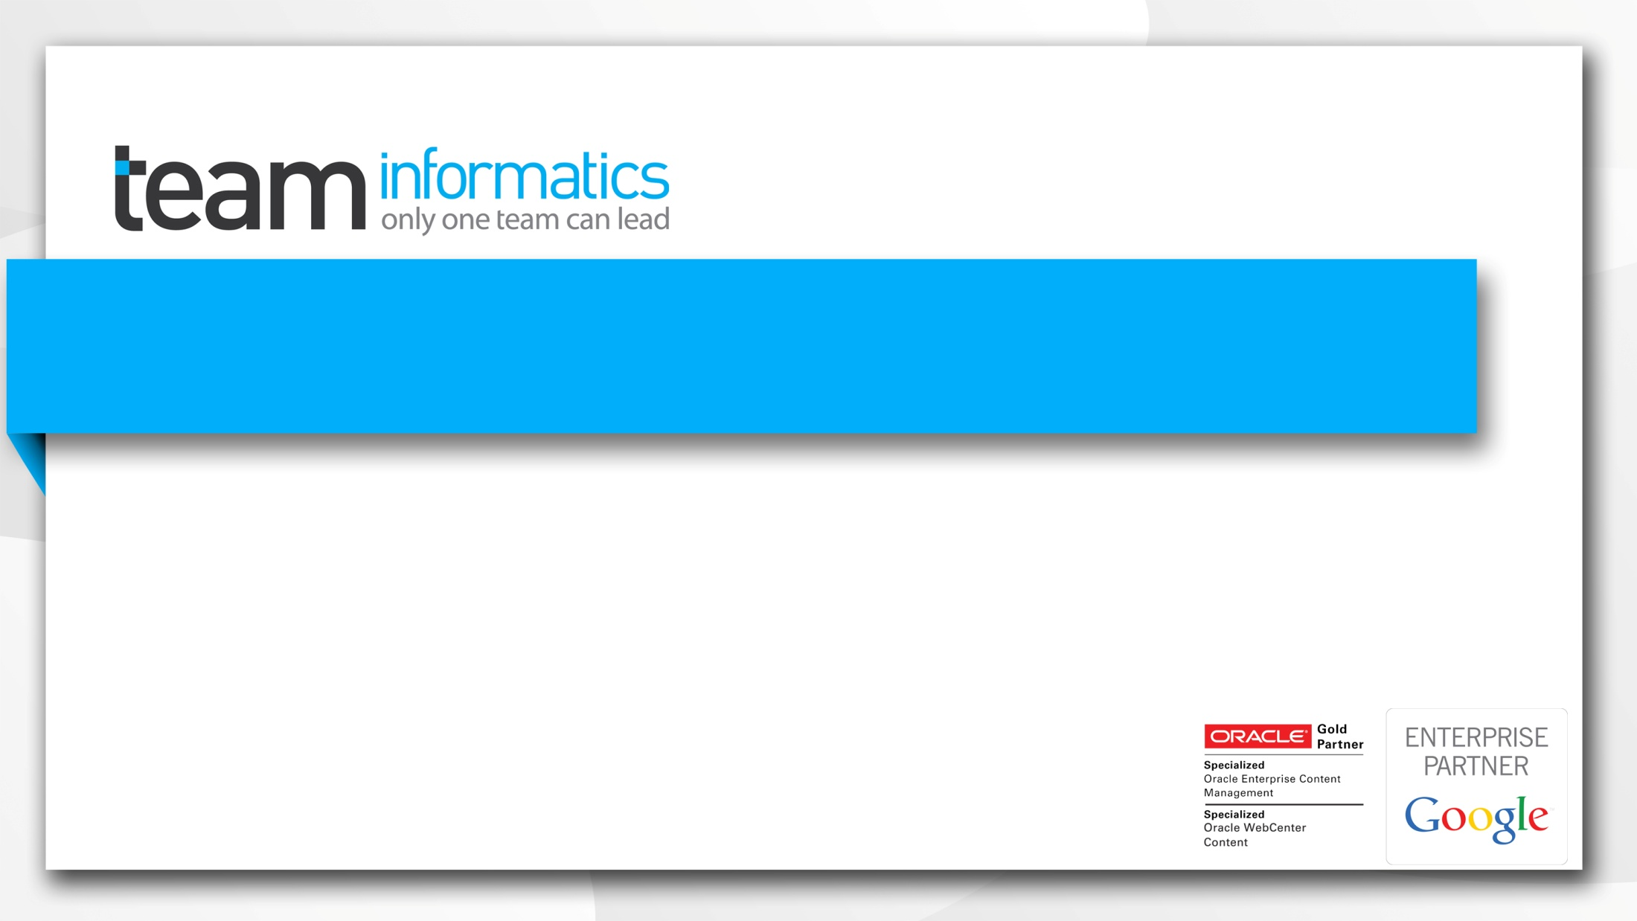

TITLE
Author
Be in front Stay in front

Slide 2

Agenda
Our Company & Credentials
Our Focus
Oracle Product Roadmap
Extending Oracle WebCenter
How Can We Help You

Slide 3

Background
Procurement Reform Programme
AoG and Collaborative Contracts
ECMS Collaborative Contract
IaaS Collaborative Contract
Partnerships and history

Slide 4
Overview of the ContentWorx Solution
(3) Collaboration
(4) Library Services
(3.1) Document
Centric
(3.2) Community
(3.3) Mobility
Location Tracking
Request Management
Extends to
Extends to
(1) Content Management
(2) Records Management
(1.1) Document
Management
(1.2) Image and Rich Media Management
(1.3) Workflow
(1.4) Search
Extends to
(2.1) Archiving
(1.5) Digital Rights Management
(1.6) Digitisation and Image Management
(1.7) Metadata and Taxonomy Management
(1.8) Auto Classification
(2.2) Lifecycle
Management

Slide 5
Core Content Management Services
Content Management Services
View/Markup Services
Retention Services
Classification Services
Security/Permissions
Subscription Services
Digital Rights Services
Rendition Services
Audit/Tracking
Metadata Management
Enterprise Content Management Repository
Compression
Encryption
De-Duplication
Index/Search
Tiered Storage (IaaS)

Slide 6
Collaboration Services
Content Collaboration Services
Collaboration
Services
Document Collaboration
Community Workspaces
Mobility
Ent.App. Mashup
Personalisation
Enterprise Portals
System Reporting
Access
Content Management Services
Identity Management Services
Solution Management Services
View/Markup Services
Retention Services
Classification Services
Security/Permissions
Subscription Services
Digital Rights Services
Monitoring
Identity
Rendition Services
Audit/Tracking
Metadata Management
Core ECM Services
Enterprise Content Management Repository
Compression
Encryption
De-Duplication
Index/Search
Tiered Storage (IaaS)

Slide 7
Advanced Workflow Services (BPM Suite)
Business Intelligence Services
Analytics
Solution Reporting
Mgmnt. Dashboards
Content Workflow Services
Integration Services
System Reporting
Access
Modeling
Monitoring
Execution
Data
Application
Solution Management Services
Identity Management Services
Content Management Services
View/Markup Services
Retention Services
Classification Services
Security/Permissions
Subscription Services
Digital Rights Services
Monitoring
Identity
Rendition Services
Audit/Tracking
Metadata Management
Enterprise Content Management Repository
Compression
Encryption
De-Duplication
Index/Search
Tiered Storage (IaaS)

Slide 8
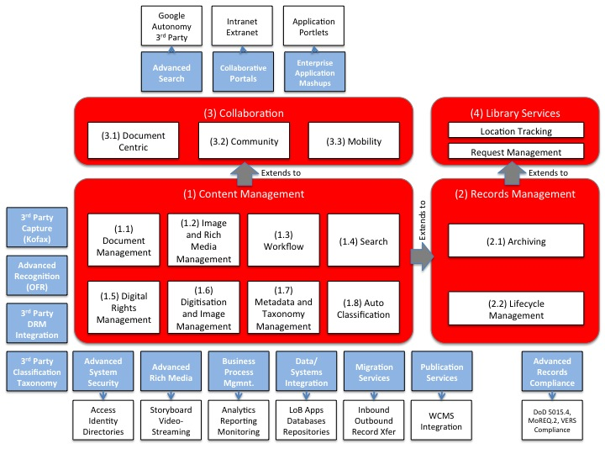
Additional Service Offerings

Slide 9
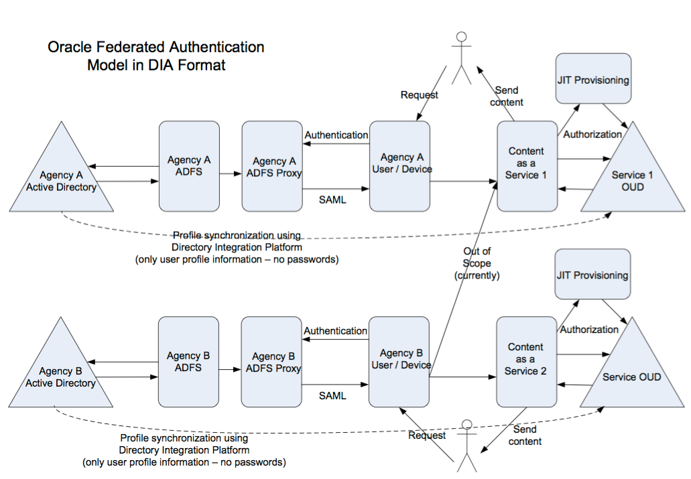
Security Integrations

Slide 10
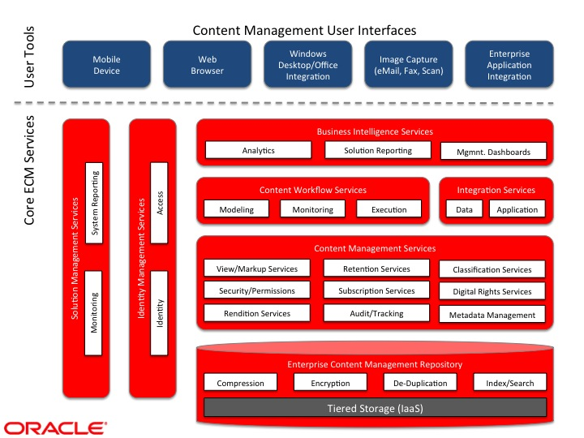
Client Access

Slide 11
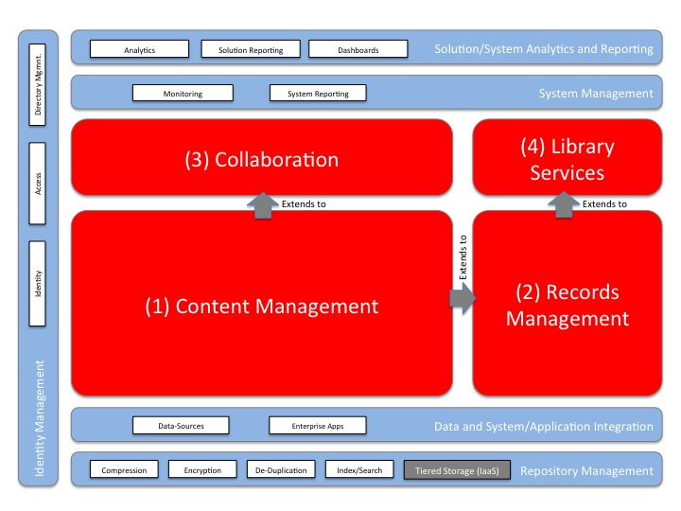
Management and Support Services

Slide 12
High Level Architecture

Slide 13
Deployment - conceptual

Slide 14
Standard Deployment

Slide 15
High Availability

Slide 16
Low level - protocols

